Slide 1





CPSC-4190-01 FA 2019 TEAM 3
Brittany
Lynch
1178633
"Brittany"
Dayne
Longtin
1182960
"Dayne"
Eric
Gomez
1183748
“Eric”
Jimmy
Ellis
1192723
“Jimmy"
Michael
McRae
1195717
"Michael"

Slide 2
Feature Description
This mobile application will enable users to access a multitude of backgrounds and quotes and create beautiful compositions of images and quotes. These quotes and backgrounds can range from: inspirational quotes, humor quotes, personal quotes, romantic quotes, nature backgrounds, national park backgrounds and personal photos. The application will enable the user to configure said backgrounds and quotes differently. If the user would like the background and quote to display with different settings in a sequential, random or fixed rate, they can do so. With this in mind; the user will be able to create, edit and delete said compositions, and save or publish the compositions at any time.

Slide 3
Technical Description
Java Programming Language is being used to create an APK for the computer program to be uploaded to the app store. The photos are stored in a database. The information that is held in the application from the user consists of pictures and text quotes. This information is all stored in a local database. The text information are all “string” data in code and the information stored. The pictures are all in jpeg format stored locally on the application.

Slide 4
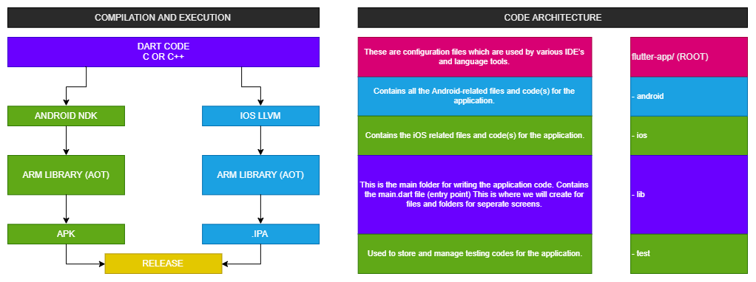
FLUTTER
Flutter is a new tool offered by Google that allows developers to build cross-platform applications to be executed in different platforms like Android and iOS in one common codebase.

Slide 5
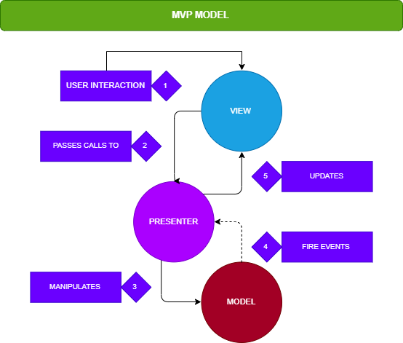
MODEL–VIEW–PRESENTER
BUILDING USER INTERFACES
The model is an interface defining the data to be displayed or otherwise acted upon in the user interface.
The view is an inactive interface that displays data (the model) and routes user commands (events) to the presenter to act upon that data.
The presenter acts upon the model and the view. It retrieves data from sources (the model), and formats it for display in the view.

Slide 6
DATA BASE TABLE
Images (imageid, title, imageblob, categoryid)
imageid has unique auto increment values
title, string value for title
imageblob, encoded image
catagoryid foreign key for Image categories
Quotes (quoteid, title, quote, categoryid)
quoteid has unique auto increment values
title, string value for title
quote, string value for quote
catagoryid foreign key for Quote categories
Playlist (playlistid, title)
quoteid has unique auto increment values
title, string value for title
Slide (slideid, order, playlistid quoteid, imageid)
quoteid has unique auto increment values
order int value
playlistid foreign key for Playlist
quoteid foreign key for Quote
imageid foreign key for Image
Motivational Message (messageid, message)
messageid has unique auto increment values
Users (userid)
userid and settingsid have unique auto increment values
Image Categories (categoryid, title, userid)
categoryid has a unique auto increment value and userid is related to Users table
title – string with image category title.
Quote Categories (categoryid, title, userid)
categoryid has a unique auto increment value and userid is related to Users table
title – string with quote category title.
Settings (settingsid, shuffle, quotespeed, picturespeed, userid)
settingsid has unique auto increment values
[pending - storing indexes for image and quote]

Slide 7
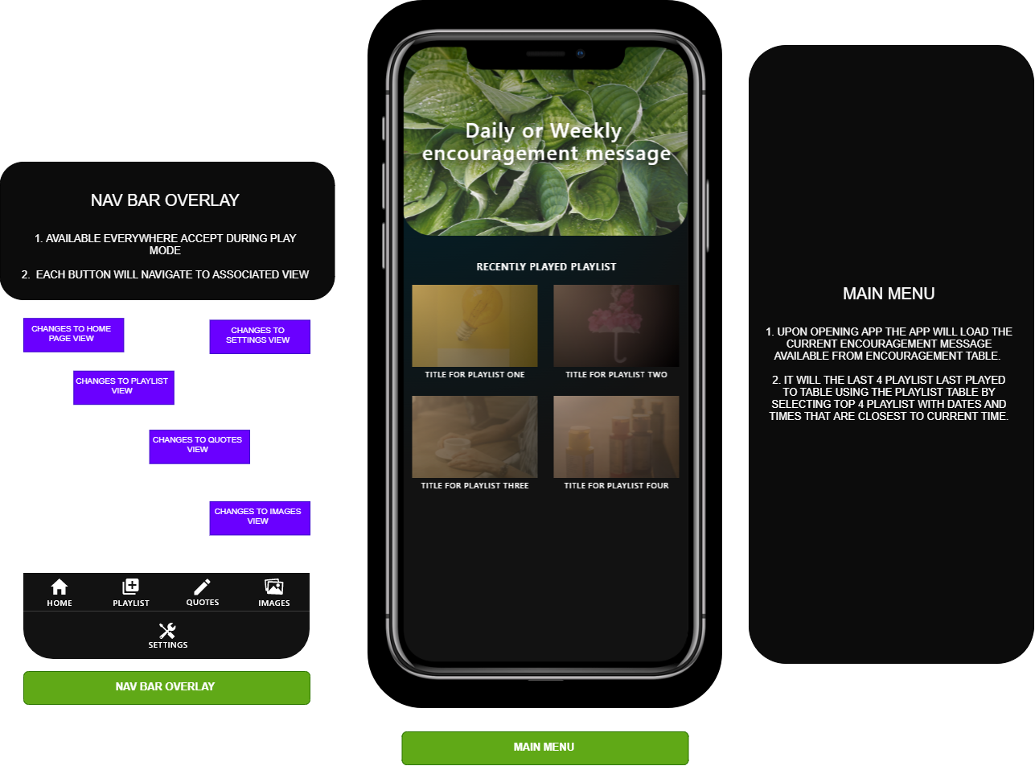

Slide 8
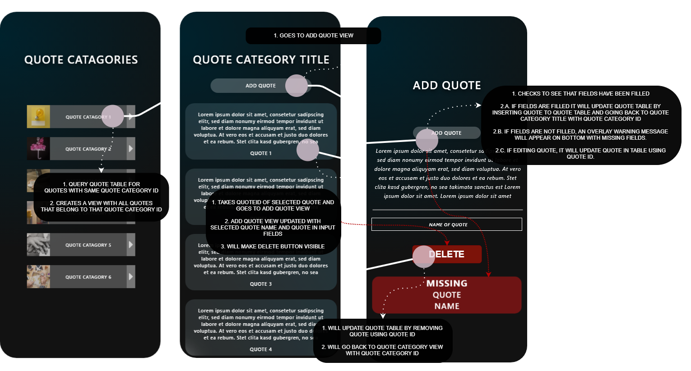
HANDLING QUOTES

Slide 9
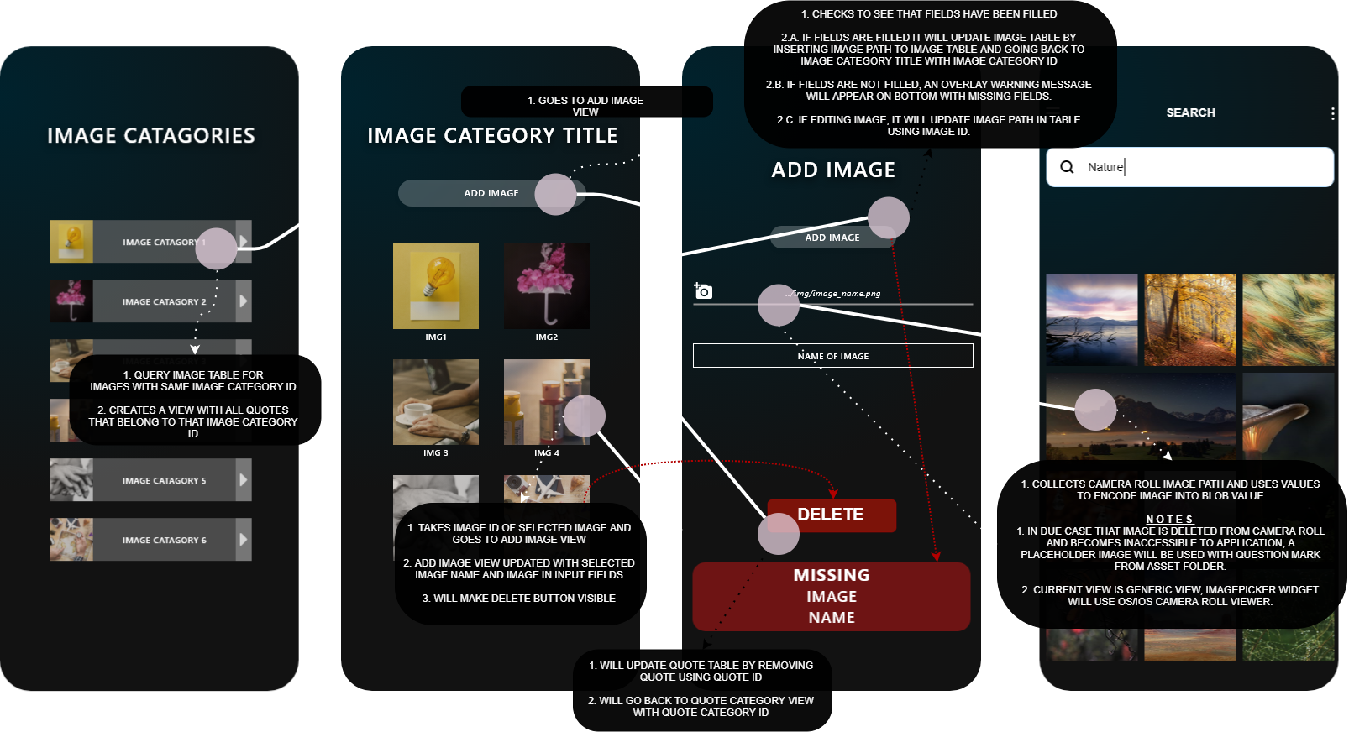
HANDLING IMAGES

Slide 10
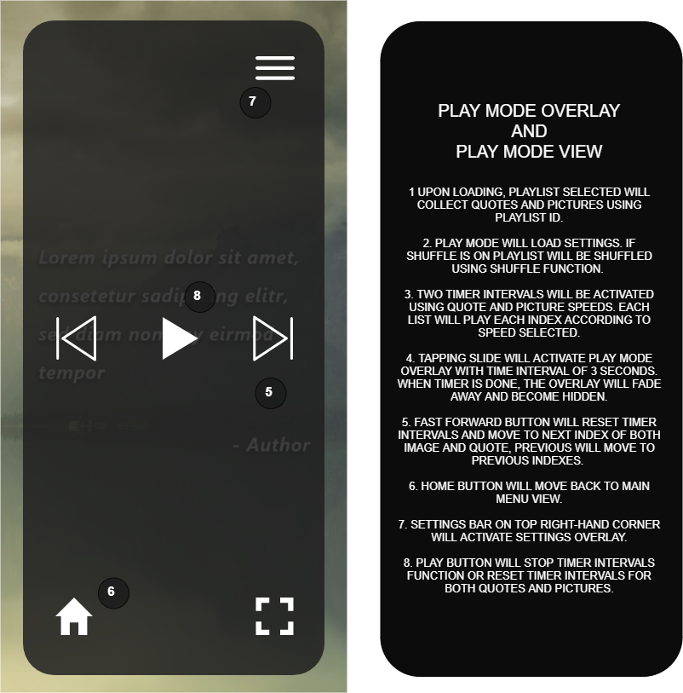
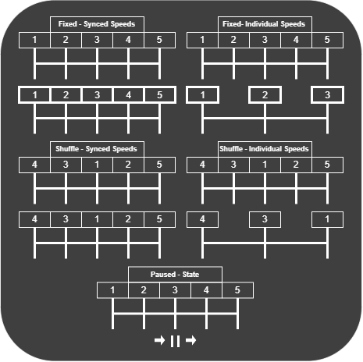
PLAY MODE STATES

Slide 11
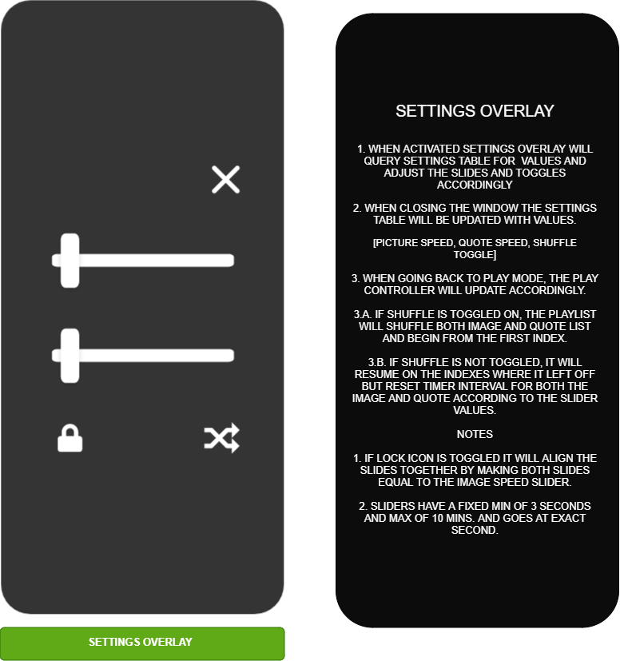

Slide 12
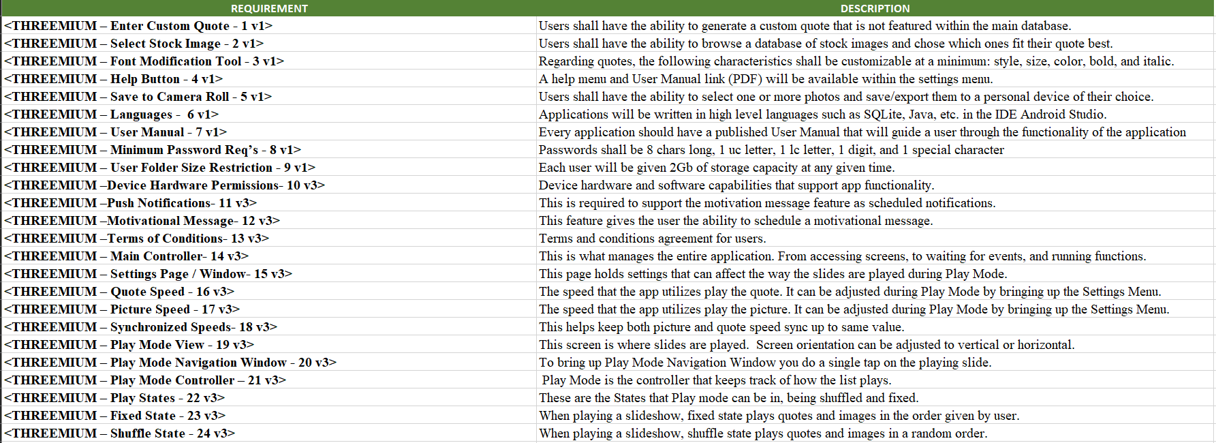
REQUIREMENTS

Slide 13
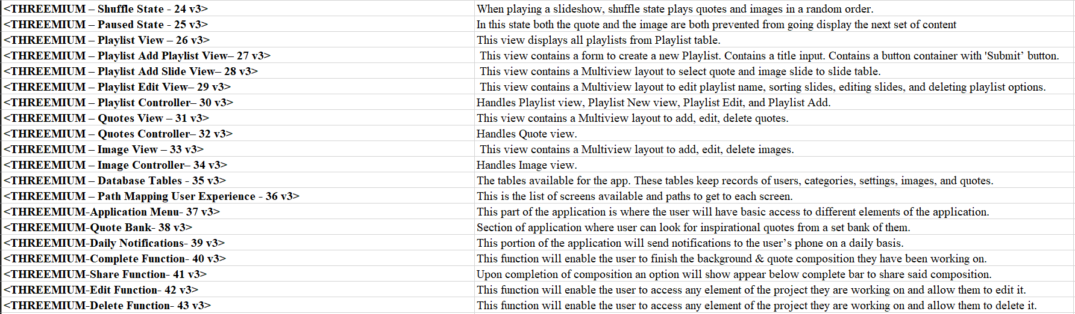
REQUIREMENTS CONTINUED

Slide 14
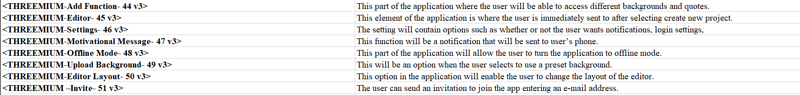
REQUIREMENTS CONTINUED

